Slide 1
Architecture of Enterprise Applications 4 Transaction Management
Haopeng Chen
REliable, INtelligent and Scalable Systems Group (REINS)
Shanghai Jiao Tong University
Shanghai, China
http://reins.se.sjtu.edu.cn/~chenhp
e-mail: chen-hp@sjtu.edu.cn

Slide 2
Contents and Objectives
Contents
What Is a Transaction?
Container-Managed Transactions
Isolation and Database Locking
Updating Multiple Databases
Objectives
能够根据数据访问的具体场景设计并实现事务管理方案，包括事务边界划分和事务隔离级别设置

Slide 3
Transactions in Java EE Applications
In a Java EE application, a transaction
is a series of actions that must all complete successfully, or else all the changes in each action are backed out. Transactions end in either a commit or a rollback.
The Java Transaction API (JTA) allows applications
to access transactions in a manner that is independent of specific implementations
The JTA defines the UserTransaction interface that applications use to start, commit, or roll back transactions.
Application components get a UserTransaction object through a JNDI lookup by using the name java:comp/UserTransaction or by requesting injection of a UserTransaction object.

Slide 4
What Is a Transaction?
Pseudocode:
begin transaction
debit checking account
credit savings account
update history log
commit transaction
A transaction is often defined as an indivisible unit of work
Either all or none of the three steps must complete.
A transaction can end in two ways:
with a commit or with a rollback.

Slide 5
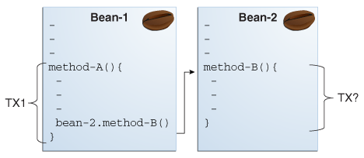
Container-Managed Transactions
In an enterprise bean with container-managed transaction demarcation,
the EJB container sets the boundaries of the transactions.

Slide 6
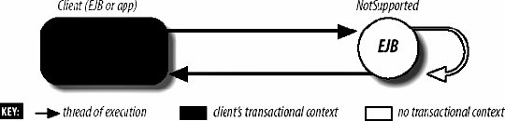
Transaction attributes defined
NotSupported
Invoking a method on an app with this transaction attribute suspends the transaction until the method is completed.

Slide 7
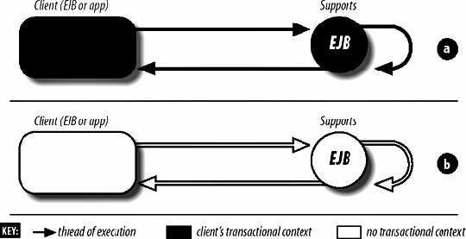
Transaction attributes defined
Supports
This attribute means that the app method will be included in the transaction scope if it is invoked within a transaction.

Slide 8
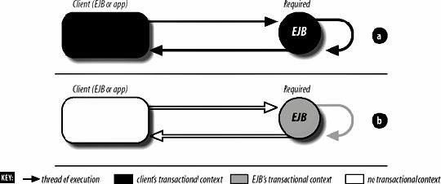
Transaction attributes defined
Required
This attribute means that the app method must be invoked within the scope of a transaction.

Slide 9
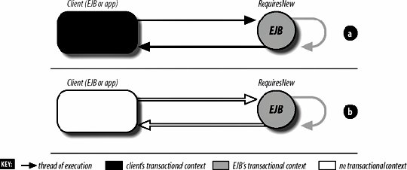
Transaction attributes defined
RequiresNew
This attribute means that a new transaction is always started.

Slide 10
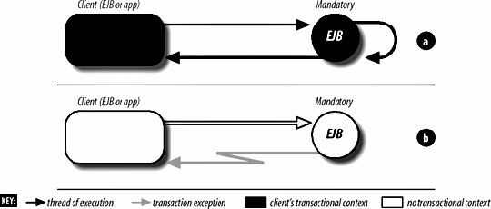
Transaction attributes defined
Mandatory
This attribute means that the app method must always be made part of the transaction scope of the calling client.

Slide 11
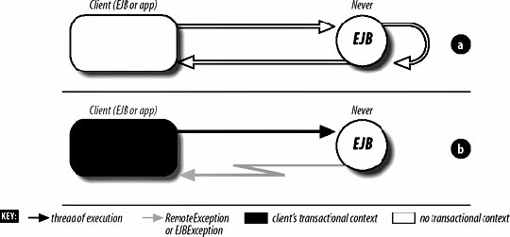
Transaction attributes defined
Never
This attribute means that the app method must not be invoked within the scope of a transaction.

Slide 12
Transaction Attributes and Scope
Transaction Attribute | Client's Transaction | Business Method's Transaction
Required | None | T2
Required | T1 | T1
RequiresNew | None | T2
RequiresNew | T1 | T2
Mandatory | None | Error
Mandatory | T1 | T1
NotSupported | None | None
NotSupported | T1 | None
Supports | None | None
Supports | T1 | T1
Never | None | None
Never | T1 | Error

Slide 13
Setting Transaction Attributes
Transaction attributes are specified by
decorating the enterprise bean class or method with a javax.ejb.TransactionAttribute annotation
and setting it to one of the javax.ejb.TransactionAttributeType constants.
Transaction Attribute | TransactionAttributeType Constant
Required | TransactionAttributeType.REQUIRED
RequiresNew | TransactionAttributeType.REQUIRES_NEW
Mandatory | TransactionAttributeType.MANDATORY
NotSupported | TransactionAttributeType.NOT_SUPPORTED
Supports | TransactionAttributeType.SUPPORTS
Never | TransactionAttributeType.NEVER

Slide 14
Setting Transaction Attributes
The following code snippet demonstrates how to use the @TransactionAttribute annotation:
@TransactionAttribute(NOT_SUPPORTED)
@Stateful
public class TransactionBean implements Transaction {
...
@TransactionAttribute(REQUIRES_NEW)
public void firstMethod() {...}
@TransactionAttribute(REQUIRED)
public void secondMethod() {...}
public void thirdMethod() {...}
public void fourthMethod() {...}
}

Slide 15
Rolling Back a CMT
There are two ways to roll back a container-managed transaction.
First, if a system exception is thrown, the container will automatically roll back the transaction.
Second, by invoking the setRollbackOnly method of the EJBContext interface, the bean method instructs the container to roll back the transaction.
If the bean throws an application exception, the rollback is not automatic but can be initiated by a call to setRollbackOnly.

Slide 16
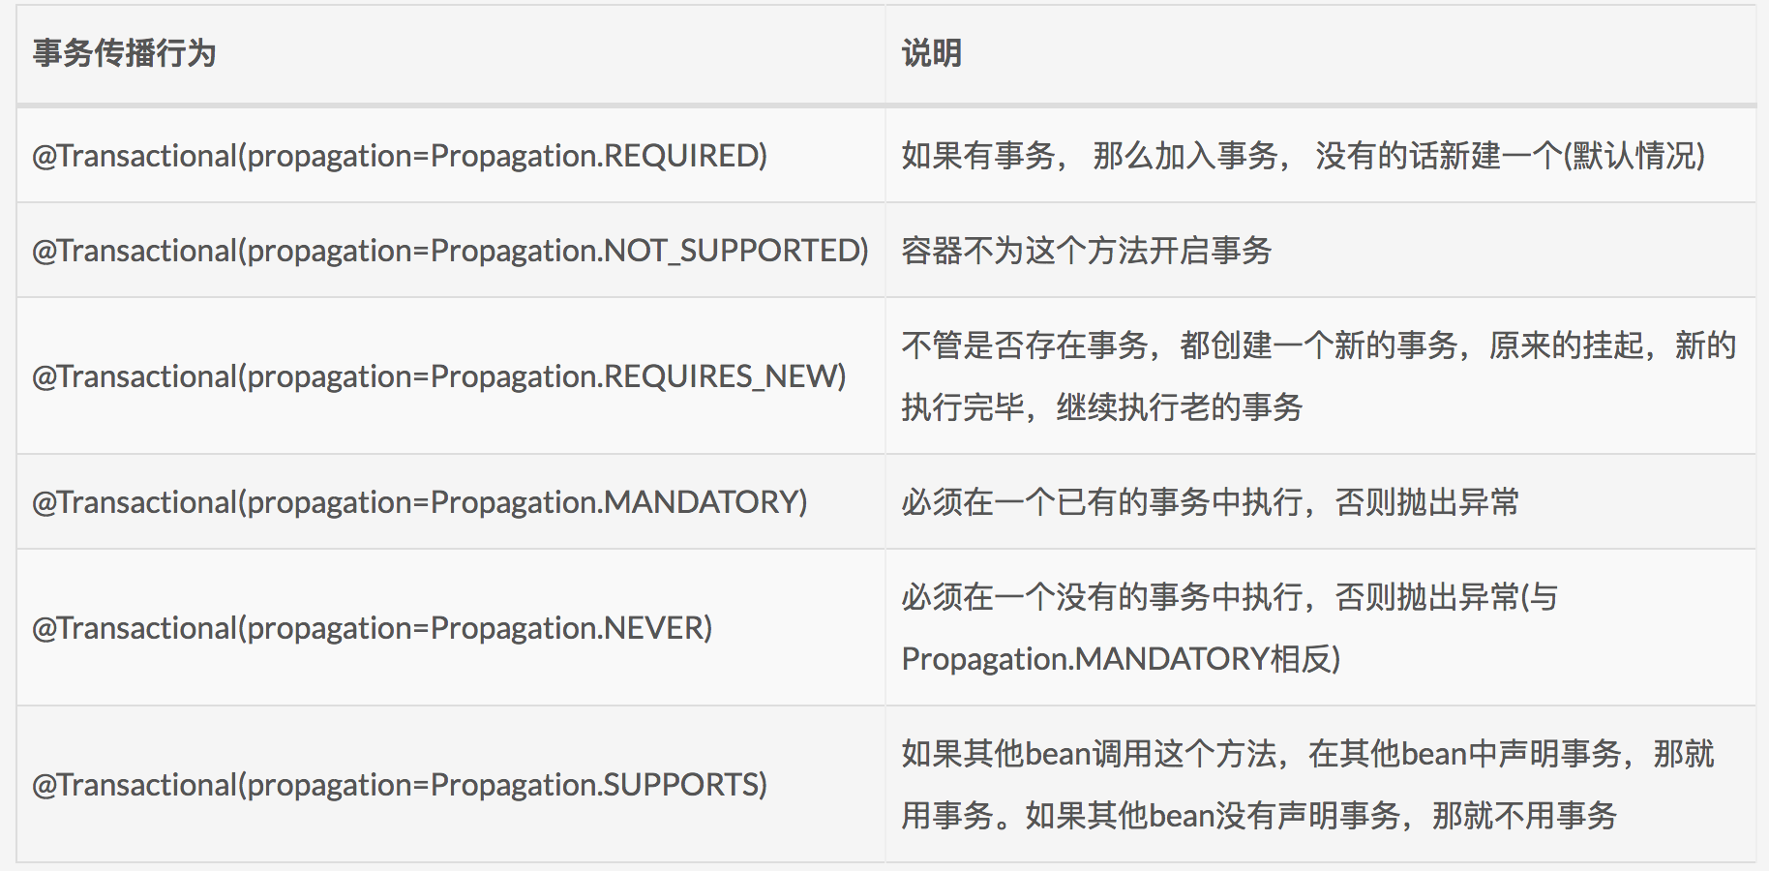
Managing Transactions in Spring
@Transactional propagation

Slide 17
Managing Transactions in Spring
BookingService.java @Component public class BookingService { private final static Logger logger = LoggerFactory.getLogger(BookingService.class); private final JdbcTemplate jdbcTemplate; public BookingService(JdbcTemplate jdbcTemplate) { this.jdbcTemplate = jdbcTemplate; } @Transactional public void book(String... persons) { for (String person : persons) { logger.info("Booking " + person + " in a seat..."); jdbcTemplate.update("insert into BOOKINGS(FIRST_NAME) values (?)", person); } } public List<String> findAllBookings() { return jdbcTemplate.query("select FIRST_NAME from BOOKINGS", (rs, rowNum) -> rs.getString("FIRST_NAME")); } }

Slide 18
Managing Transactions in Spring
AppRunner.java
@Component class AppRunner implements CommandLineRunner { private final static Logger logger = LoggerFactory.getLogger(AppRunner.class); private final BookingService bookingService; public AppRunner(BookingService bookingService) { this.bookingService = bookingService; } @Override public void run(String... args) throws Exception { bookingService.book("Alice", "Bob", "Carol"); Assert.isTrue(bookingService.findAllBookings().size() == 3, "First booking should work with no problem"); logger.info("Alice, Bob and Carol have been booked"); try { bookingService.book("Chris", "Samuel"); } catch (RuntimeException e) { logger.info("v--- The following exception is expect because 'Samuel' is too " + "big for the DB ---v"); logger.error(e.getMessage()); }

Slide 19
Managing Transactions in Spring
AppRunner.java
for (String person : bookingService.findAllBookings()) { logger.info("So far, " + person + " is booked."); } logger.info("You shouldn't see Chris or Samuel. Samuel violated DB constraints, " + "and Chris was rolled back in the same TX"); Assert.isTrue(bookingService.findAllBookings().size() == 3, "'Samuel' should have triggered a rollback"); try { bookingService.book("Buddy", null); } catch (RuntimeException e) { logger.info("v--- The following exception is expect because null is not " + "valid for the DB ---v"); logger.error(e.getMessage()); } for (String person : bookingService.findAllBookings()) { logger.info("So far, " + person + " is booked."); } logger.info("You shouldn't see Buddy or null. null violated DB constraints, and " + "Buddy was rolled back in the same TX"); Assert.isTrue(bookingService.findAllBookings().size() == 3, "'null' should have triggered a rollback"); } }

Slide 20
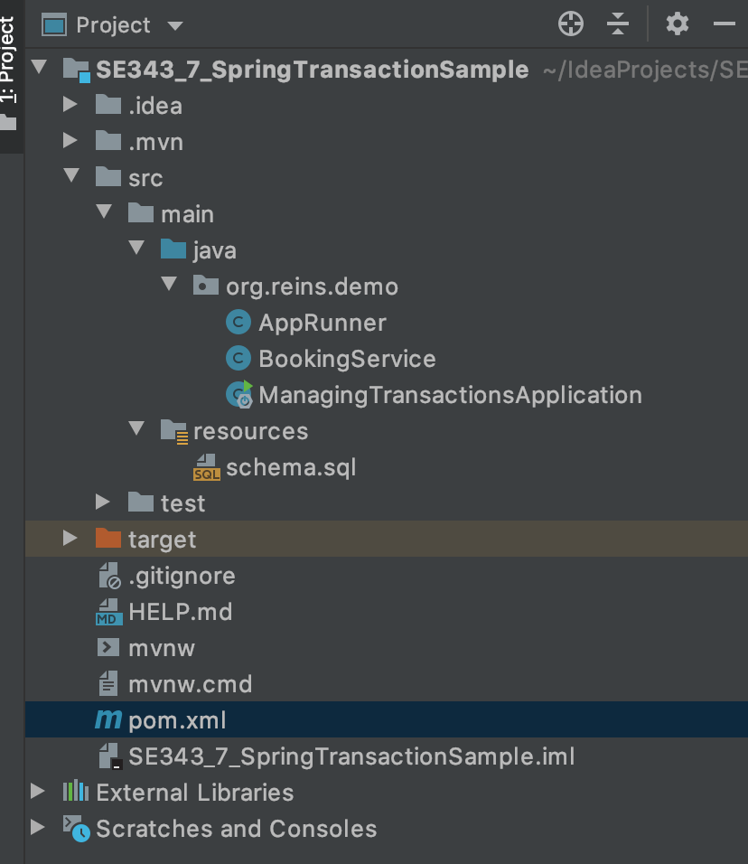
Managing Transactions in Spring
ManagingTransactionsApplication.java
@SpringBootApplication public class ManagingTransactionsApplication { public static void main(String[] args) { SpringApplication.run(ManagingTransactionsApplication.class, args); } }
schema.sql
drop table BOOKINGS if exists; create table BOOKINGS(ID serial, FIRST_NAME varchar(5) NOT NULL);
pom.xml
<dependency> <groupId>org.springframework.boot</groupId> <artifactId>spring-boot-starter-data-jdbc</artifactId> </dependency> <dependency> <groupId>com.h2database</groupId> <artifactId>h2</artifactId> <scope>runtime</scope> </dependency>

Slide 21
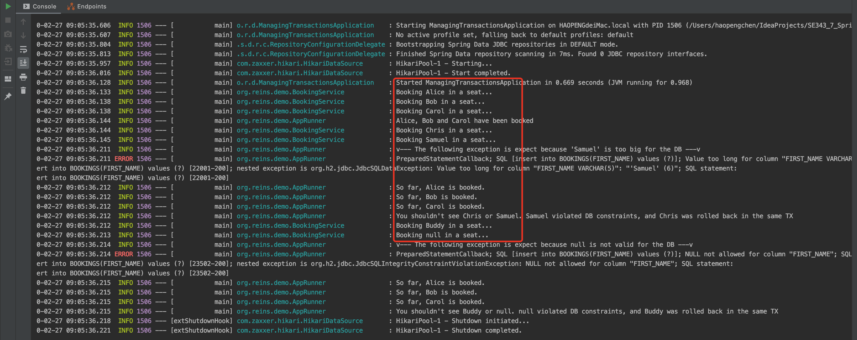
Managing Transactions in Spring

Slide 22
A Transaction Example
Bank.java
@Entity @Table(name = "bank") public class Bank { @Id @Column(name = "account", nullable = false, length = 45) private String id; @Column(name = "balance") private Integer balance; public String getId() { return id; } public void setId(String id) { this.id = id; } public Integer getBalance() { return balance; } public void setBalance(Integer balance) { this.balance = balance; } }
BankRepository.java
public interface BankRepository extends JpaRepository<Bank, String> { }
BankController.java
@RestController public class BankController { @Autowired private BankService bankService; @GetMapping(value = "/transfer") public String transfer() { System.out.println("Transferring..."); bankService.transfer("Tom", "Jerry", 80); return "Done"; } }

Slide 23
A Transaction Example
BankService.java
public interface BankService { public void transfer(String from, String to, int amount); }
BankServiceImpl.java
@Service public class BankServiceImpl implements BankService{ @Autowired private BankDao bankDao; @Override @Transactional public void transfer(String from, String to, int amount){ System.out.println(from + " " + to + amount); bankDao.withdraw(from, amount); // int result = 10 / 0; try { bankDao.deposit(to, amount); }catch (Exception e){ e.printStackTrace(); } // int result = 10 / 0; }; }
BankDao.java
public interface BankDao { public void withdraw(String from, int amount); public void deposit(String to, int amount); }
BankDaoImpl.java
@Repository public class BankDaoImpl implements BankDao { @Autowired private BankRepository bankRepository; @Transactional public void withdraw(String from, int amount) { Bank out = bankRepository.findById(from).get(); out.setBalance(out.getBalance() - amount); // int result = 10 / 0; }; @Transactional (propagation = Propagation.REQUIRES_NEW) public void deposit(String to, int amount) { Bank in = bankRepository.findById(to).get(); in.setBalance(in.getBalance() + amount); // int result = 10 / 0; }; }

Slide 24
A Transaction Example
SQL Script
DROP TABLE IF EXISTS `bank`;
CREATE TABLE `bank` (
`account` varchar(45) NOT NULL,
`balance` int DEFAULT NULL,
PRIMARY KEY (`account`)
) ENGINE=InnoDB DEFAULT CHARSET=utf8mb4 COLLATE=utf8mb4_0900_ai_ci;

Slide 25
A Transaction Example
 | transfer | withdraw | deposit | result
1 | 正常 | 正常 | 正常 | Tom - 80; Jerry + 80
2 | result = 10 / 0 | 正常 | 正常 | 整个事务回滚
3 | 正常 | result = 10 / 0 | 正常 | 整个事务回滚
4 | 正常 | 正常 | result = 10 / 0 | 整个事务回滚
5 | 正常 | 正常 | 正常 REQUIRES_NEW | 正常
6 | result = 10 / 0，在deposit之前 | 正常 | 正常 REQUIRES_NEW | 整个事务回滚
7 | result = 10 / 0，在deposit之后 | 正常 | 正常 REQUIRES_NEW | deposit成功，withdraw和transfer事务回滚
8 | 正常 | result = 10 / 0 | 正常 REQUIRES_NEW | 整个事务回滚
9 | 正常 | 正常 | result = 10 / 0 REQUIRES_NEW | withdraw和transfer成功，deposit事务回滚

Slide 26
A Transaction Example
 | CreateRecordOfBooks | AddRecord | AddItem | result
1 | 正常 | 正常 | 正常 | 购物车内容全部添加到订单
2 | result = 10 / 0 | 正常 | 正常 | 整个事务回滚
3 | 正常 | result = 10 / 0 | 正常 | 整个事务回滚
4 | 正常 | 正常 | result = 10 / 0 | 整个事务回滚
5 | 正常 | 正常 | 正常 REQUIRES_NEW | 正常
6 | result = 10 / 0，在循环之前 | 正常 | 正常 REQUIRES_NEW | 整个事务回滚
7 | result = 10 / 0，在循环之后 | 正常 | 正常 REQUIRES_NEW | deposit成功，withdraw和transfer事务回滚
8 | 正常 | result = 10 / 0 | 正常 REQUIRES_NEW | 整个事务回滚
9 | 正常 | 正常 | result = 10 / 0 REQUIRES_NEW | withdraw和transfer成功，deposit事务回滚

Slide 27
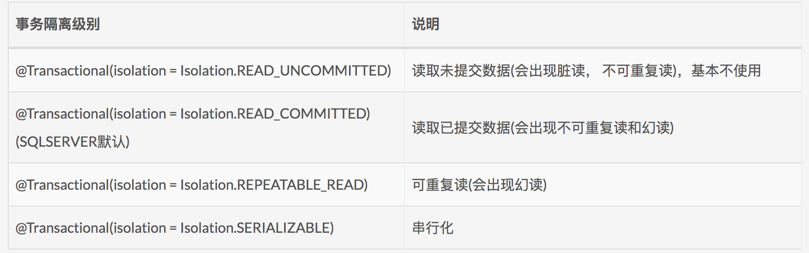
Managing Transactions in Spring
@Transactional isolation

Slide 28
Isolation and Database Locking
Let's think about two separate client applications accessing the same data specifically.
public List listAvailableCabins(int bedCount) {
Query query = entityManager.createQuery(
"SELECT name FROM Cabin c
WHERE c.ship = :ship AND
c.bedCount = :beds AND NOT ANY (
SELECT cabin from Reservation res
WHERE res.cruise = :cruise");
query.setParameter("ship", cruise.getShip( ));
query.setParameter("beds", bedCount);
query.setParameter("cruise", cruise);
return query.getResultList( );
}
For this example, assume that both methods have a transaction attribute of Required .

Slide 29
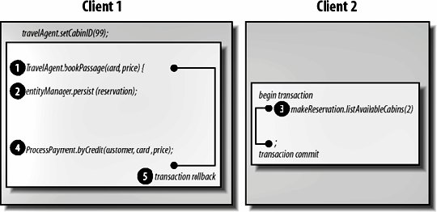
Dirty Reads

Slide 30
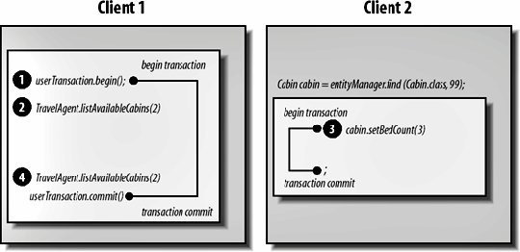
Nonrepeatable Reads

Slide 31
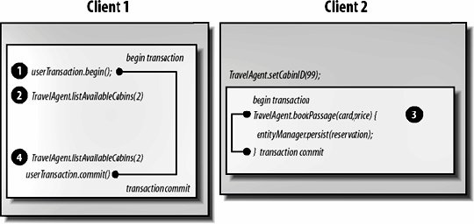
Phantom Reads

Slide 32
Database Locks
Read locks
Read locks prevent other transactions from changing data read during a transaction until the transaction ends, thus preventing nonrepeatable reads.
Other transactions can read the data but not write to it. The current transaction is also prohibited from making changes.
Write locks
Write locks are used for updates. A write lock prevents other transactions from changing the data until the current transaction is complete but allows dirty reads by other transactions and by the current transaction itself.
In other words, the transaction can read its own uncommitted changes.

Slide 33
Database Locks
Exclusive write locks
Exclusive write locks are used for updates. An exclusive write lock prevents other transactions from reading or changing the data until the current transaction is complete.
It also prevents dirty reads by other transactions.
Snapshots
A snapshot is a frozen view of the data that is taken when a transaction begins. Some databases get around locking by providing every transaction with its own snapshot.
Snapshots can prevent dirty reads, nonrepeatable reads, and phantom reads. They can be problematic because the data is not real-time data; it is old the instant the snapshot is taken.

Slide 34
Transaction Isolation Levels
Read Uncommitted
The transaction can read uncommitted data (i.e., data changed by a different transaction that is still in progress).
Dirty reads, nonrepeatable reads, and phantom reads can occur.
Bean methods with this isolation level can read uncommitted changes.
Read Committed
The transaction cannot read uncommitted data; data that is being changed by a different transaction cannot be read.
Dirty reads are prevented; nonrepeatable reads and phantom reads can occur.
Bean methods with this isolation level cannot read uncommitted data.

Slide 35
Transaction Isolation Levels
Repeatable Read
The transaction cannot change data that is being read by a different transaction.
Dirty reads and nonrepeatable reads are prevented; phantom reads can occur.
Bean methods with this isolation level have the same restrictions as those in the Read Committed level and can execute only repeatable reads.
Serializable
The transaction has exclusive read and update privileges; different transactions can neither read nor write to the same data.
Dirty reads, nonrepeatable reads, and phantom reads are prevented.
This isolation level is the most restrictive.

Slide 36
Controlling isolation levels
You to specify the transaction isolation level using the database's API.
For example:
DataSource source = (javax.sql.DataSource)
jndiCntxt.lookup("java:comp/env/jdbc/titanDB");
Connection con = source.getConnection( );
con.setTransactionIsolation(Connection.TRANSACTION_SERIALIZABLE);
In spring:
@Transactional(isolation = Isolation.READ_UNCOMMITTED)
@Transactional(isolation = Isolation.READ_COMMITTED)
@Transactional(isolation = Isolation.REPEATABLE_READ)
@Transactional(isolation = Isolation.SERIALIZABLE)

Slide 37
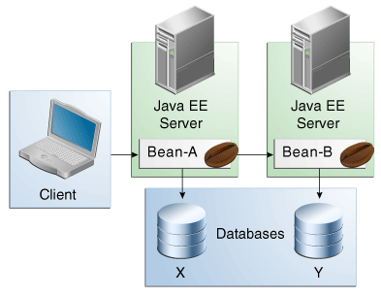
Updating Multiple Databases

Slide 38
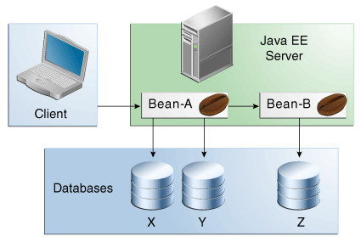
Updating Multiple Databases

Slide 39
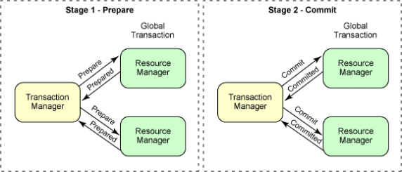
Two-phase commit

Slide 40
Concurrency
Since we use O/R mapping, and it is an offline way to access database, we should manage the concurrent access to data.
The core is how to prevent confliction between business transactions.
Locking is the solution
What kind of lock?

Slide 41
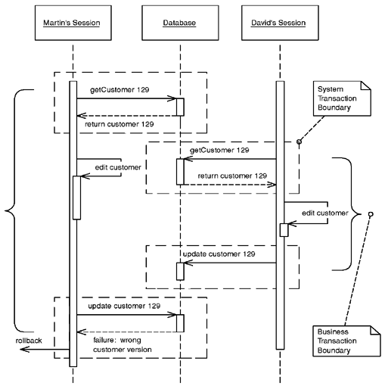
Optimistic Offline Lock
Optimistic Offline Lock solves this problem by validating that the changes about to be committed by one session don't conflict with the changes of another session.

Slide 42
Optimistic Offline Lock-How It Works
An Optimistic Offline Lock is obtained by validating that, in the time since a session loaded a record, another session hasn't altered it.
It can be acquired at any time but is valid only during the system transaction in which it is obtained.
Thus, in order that a business transaction not corrupt record data it must acquire an Optimistic Offline Lock for each member of its change set during the system transaction in which it applies changes to the database.
The most common implementation is to associate a version number with each record in your system.
With an RDBMS data store the verification is a matter of adding the version number to the criteria of any SQL statements used to update or delete a record.

Slide 43
Optimistic Offline Lock-Example
Our data is stored in a relational database,
so each table must also store version and modification data.
Here's the schema for a customer table as well as the standard CRUD SQL necessary to support the Optimistic Offline Lock:
table customer:
create table customer(id bigint primary key, name varchar, createdby varchar, created datetime, modifiedby varchar, modified datetime, version int)
SQL customer CRUD:
INSERT INTO customer VALUES (?, ?, ?, ?, ?, ?, ?)
SELECT * FROM customer WHERE id = ?
UPDATE customer SET name = ?, modifiedBy = ?, modified = ?, version = ?
WHERE id = ? and version = ?
DELETE FROM customer WHERE id = ? and version = ?

Slide 44
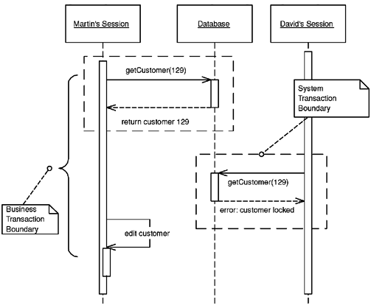
Pessimistic Offline Lock
Pessimistic Offline Lock prevents conflicts by avoiding them altogether.
It forces a business transaction to acquire a lock on a piece of data before it starts to use it, so that, most of the time, once you begin a business transaction you can be pretty sure you'll complete it without being bounced by concurrency control.

Slide 45
Pessimistic Offline Lock-How It Works
You implement Pessimistic Offline Lock in three phases:
determining what type of locks you need,
building a lock manager,
and defining procedures for a business transaction to use locks.
Lock types:
exclusive write lock
exclusive read lock
read/write lock
Read and write locks are mutually exclusive.
Concurrent read locks are acceptable.
In choosing the correct lock type think about maximizing system concurrency, meeting business needs, and minimizing code complexity.
Also keep in mind that the locking strategy must be understood by domain modelers and analysts.

Slide 46
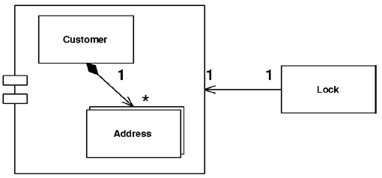
Coarse-Grained Lock
Locks a set of related objects with a single lock.
A Coarse-Grained Lock
is a single lock that covers many objects.
It not only simplifies the locking action itself but also frees you from having to load all the members of a group in order to lock them.

Slide 47
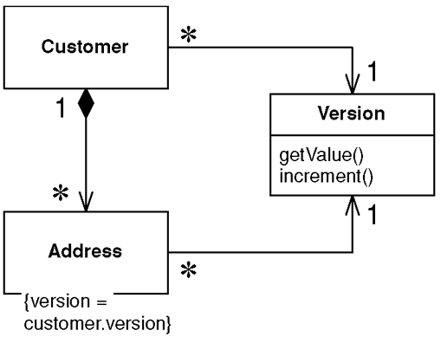
Coarse-Grained Lock-How It Works
With Optimistic Offline Lock, having each item in a group share a version creates the single point of contention, which means sharing the same version, not an equal version.
Incrementing this version will lock the entire group with a shared lock.
Set up your model to point every member of the group at the shared version and you have certainly minimized the path to the point of contention.

Slide 48
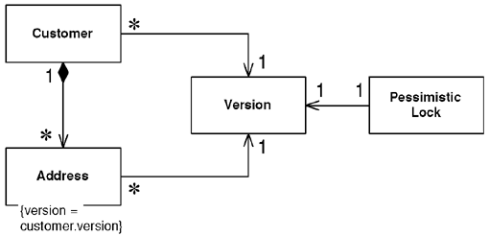
Coarse-Grained Lock-How It Works
A shared Pessimistic Offline Lock requires that each member of the group share some sort of lockable token, on which it must then be acquired.
As Pessimistic Offline Lock is often used as a complement to Optimistic Offline Lock, a shared version object makes an excellent candidate for the lockable token role.

Slide 49
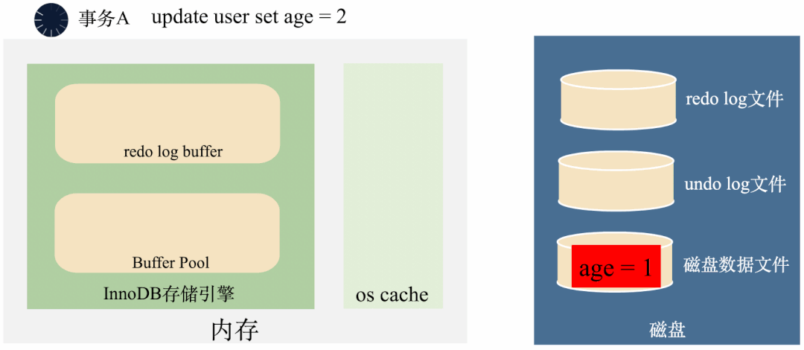
MySQL中的事务
3000帧动画图解MySQL为什么需要binlog、redo log和undo log
https://blog.csdn.net/hollis_chuang/article/details/125383029

Slide 50
References
The Java EE 8 Tutorial - Transactions
https://javaee.github.io/tutorial/transactions.html#BNCIH
Managing Transactions
https://spring.io/guides/gs/managing-transactions/
Patterns of Enterprise Application Architecture
By Martin Fowler, David Rice, Matthew Foemmel, Edward Hieatt, Robert Mee, Randy Stafford
Publisher : Addison Wesley
Software Architecture in Practice, Second Edition
By Len Bass, Paul Clements, Rick Kazman
Publisher : Addison Wesley

Slide 51

Thank You!

